Slide 1
Interactive Quiz Application
Team Members :
Abdul Javid Sulaiman
Sabeena Banu
Dinesh Kumar

Slide 2
Introduction :
Objective :
An interactive quiz application is a type of program that allows users to answer a series of questions and receive feedback on whether their answers are correct or incorrect. It is a great way to assess knowledge on a given subject and can be used in educational tools, games, or assessments.
Description :
In Python, we can create a simple interactive quiz using basic programming constructs such as loops, conditionals, and user input functions

Slide 3
Features of this application :
Question : The program presents a question to the user along with multiple-choice options.
User Input: The user inputs their answer by selecting the corresponding number for the option.
Answer Evaluation: The program checks whether the selected answer is correct or not.
Tracking the score : It keeps track of the user's score based on their correct answers.
Feedback: The program provides real-time feedback after each question (correct or wrong).
Final Score: At the end of the quiz, the program displays the final score to the user

Slide 4
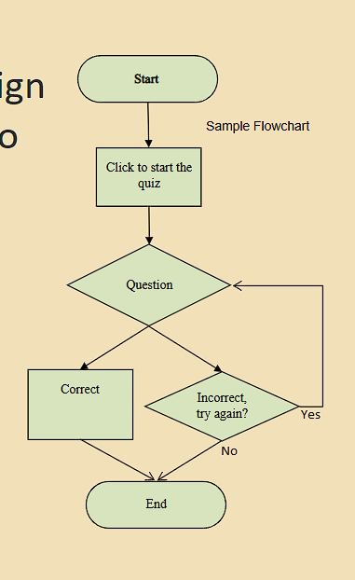
FlowChart

Slide 5
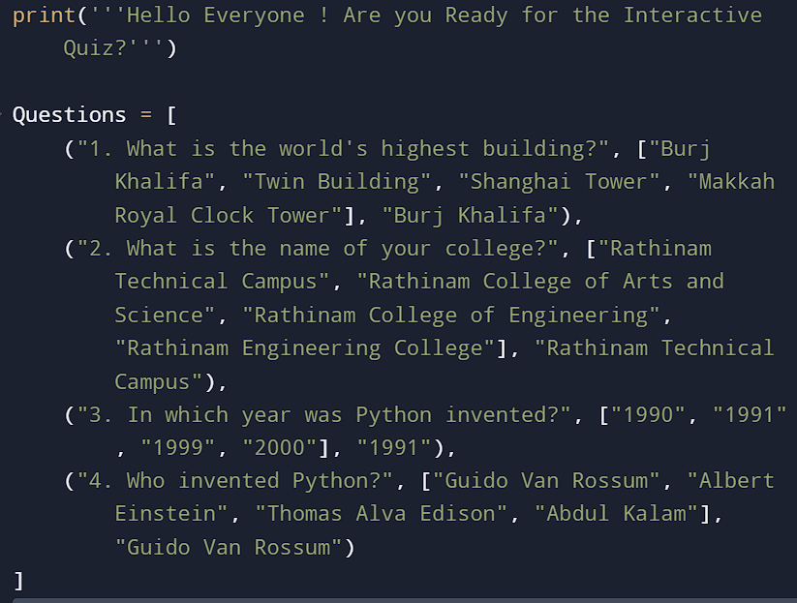
Code :
Declaring Questions :

Slide 6
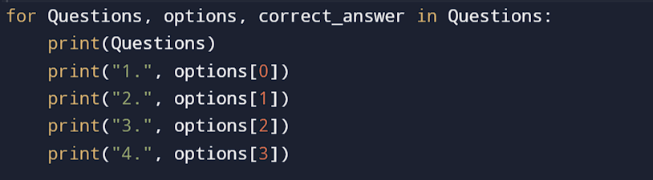
Using ForLoop :
for loop is used to iterate through a list of questions, options, and correct answers. This allows the program to display each question and check the user's response without needing to manually repeat code for each question

Slide 7
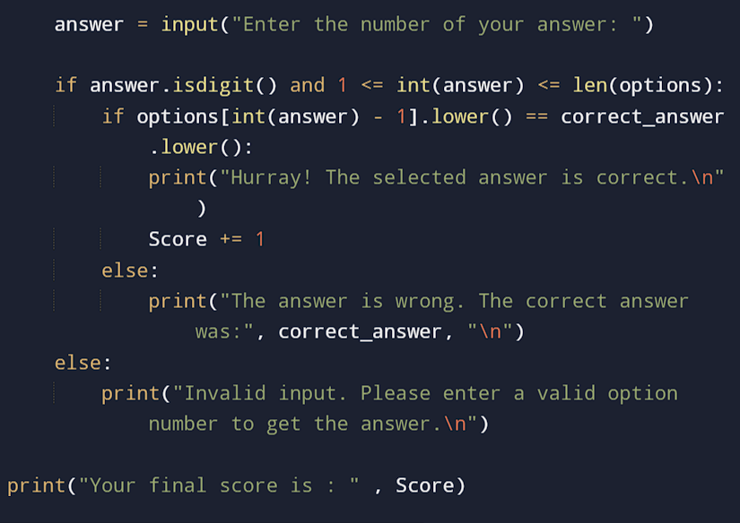
Using Conditionals:
Here we use if condition , because the isdigit() checks the answer is integer or not , then it goes to next step or otherwise it returns the else statement with the corrected answer .

Slide 8
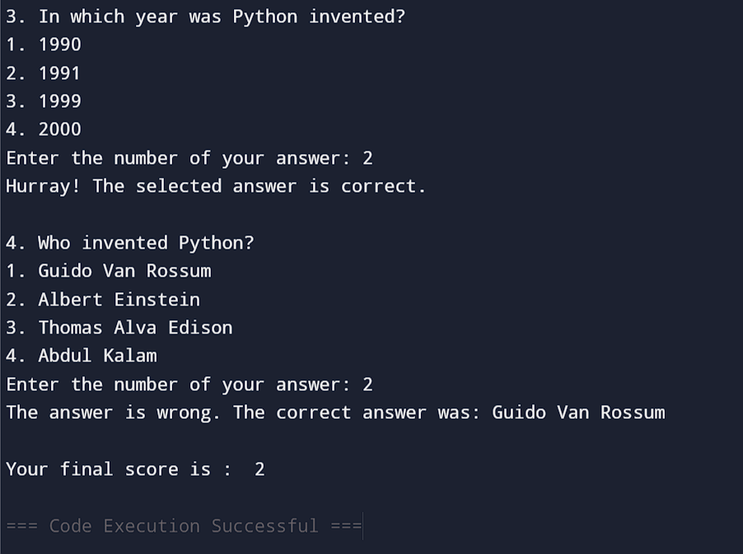
Sample Output :

Slide 9
Conclusion :
The Interactive Quiz Application is a versatile and fun tool for both educational purposes and entertainment

